Slide 1
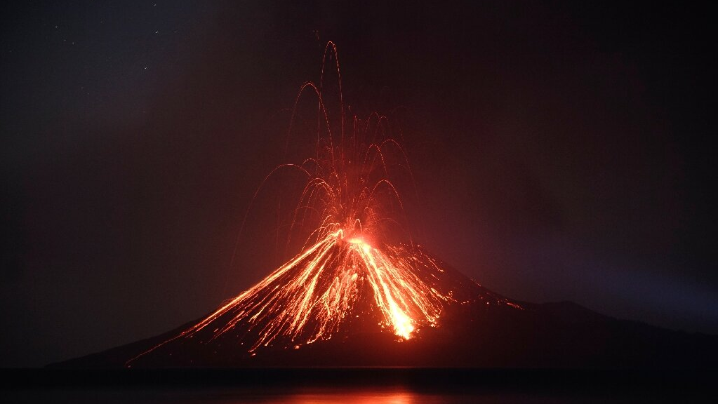
The Eruption of Krakatoa in 1883

Slide 2
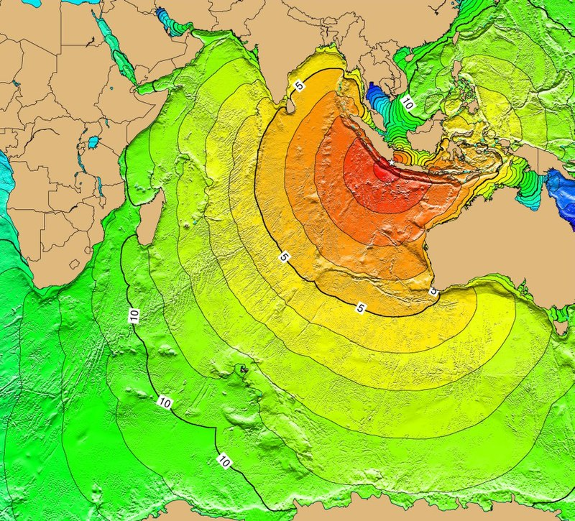
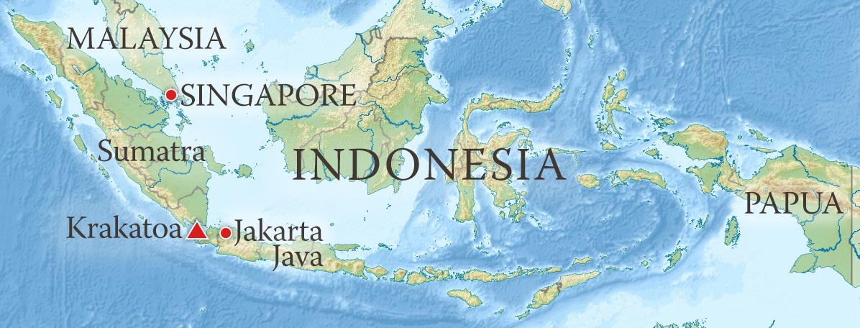
What Happened?
Location of Krakatao
Tsunami map

Slide 3
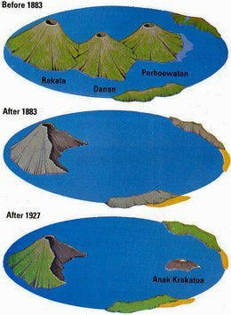
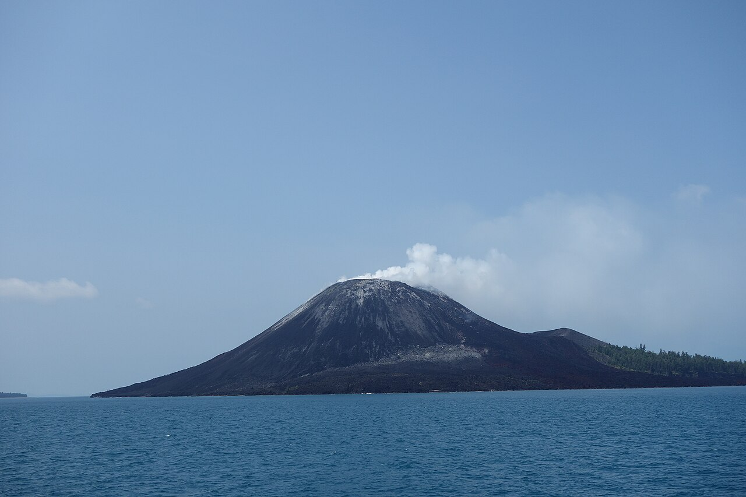
The impact and why is it important?
Anak Krakatao (Childe of Krakatao)
Krakatao today

Slide 4
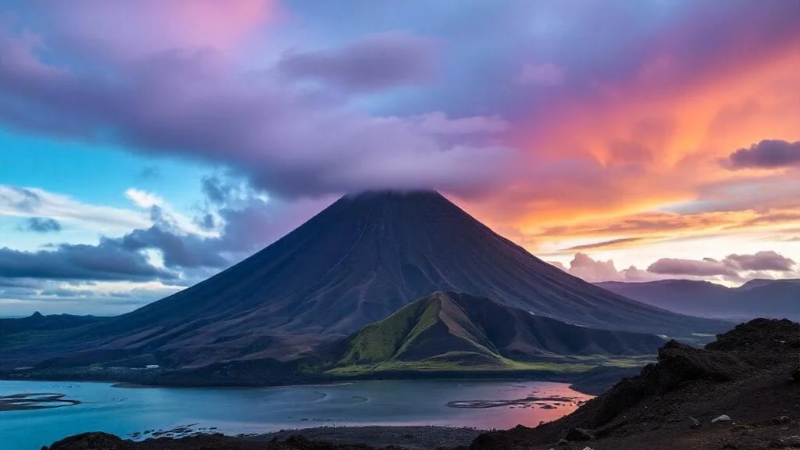
Thank you for your attention!

